Slide 1


Slide 2
KNN
Best parameters: {'metric': 'euclidean', 'n_neighbors': 3, 'weights': 'distance'}
Best cross-validation score: 97.40%
Test Accuracy: 97.89%
Classification Report:
Final Test Accuracy: 97.89%
Gas Class | Precision | Recall | F1-Score | Support
Mixture | 1.00 | 1.00 | 1.00 | 320
NoGas | 0.97 | 0.94 | 0.96 | 320
Perfume | 0.95 | 0.97 | 0.96 | 320
Smoke | 1.00 | 1.00 | 1.00 | 320
Accuracy | - | - | 0.98 | 1280
Macro Avg | 0.98 | 0.98 | 0.98 | 1280
Weighted Avg | 0.98 | 0.98 | 0.98 | 1280

Slide 3
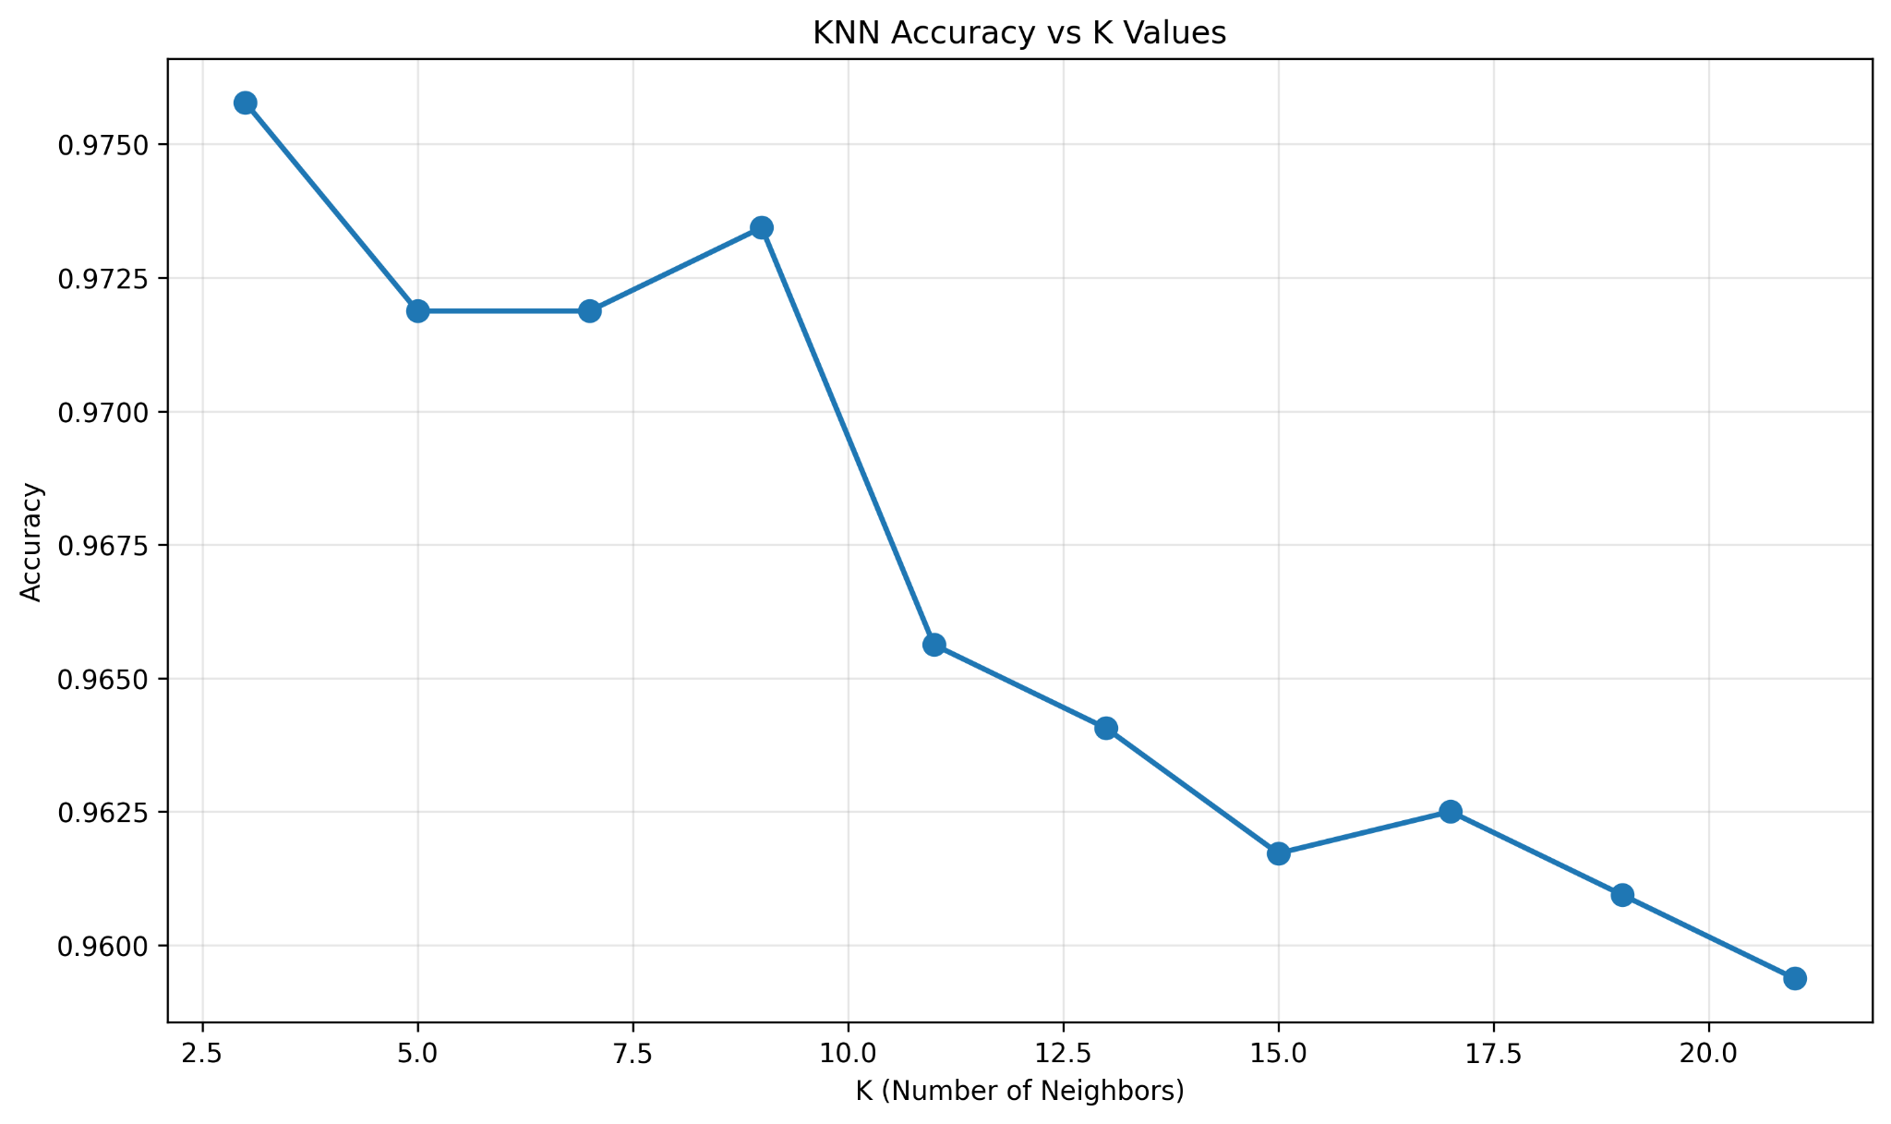
KNN

Slide 4
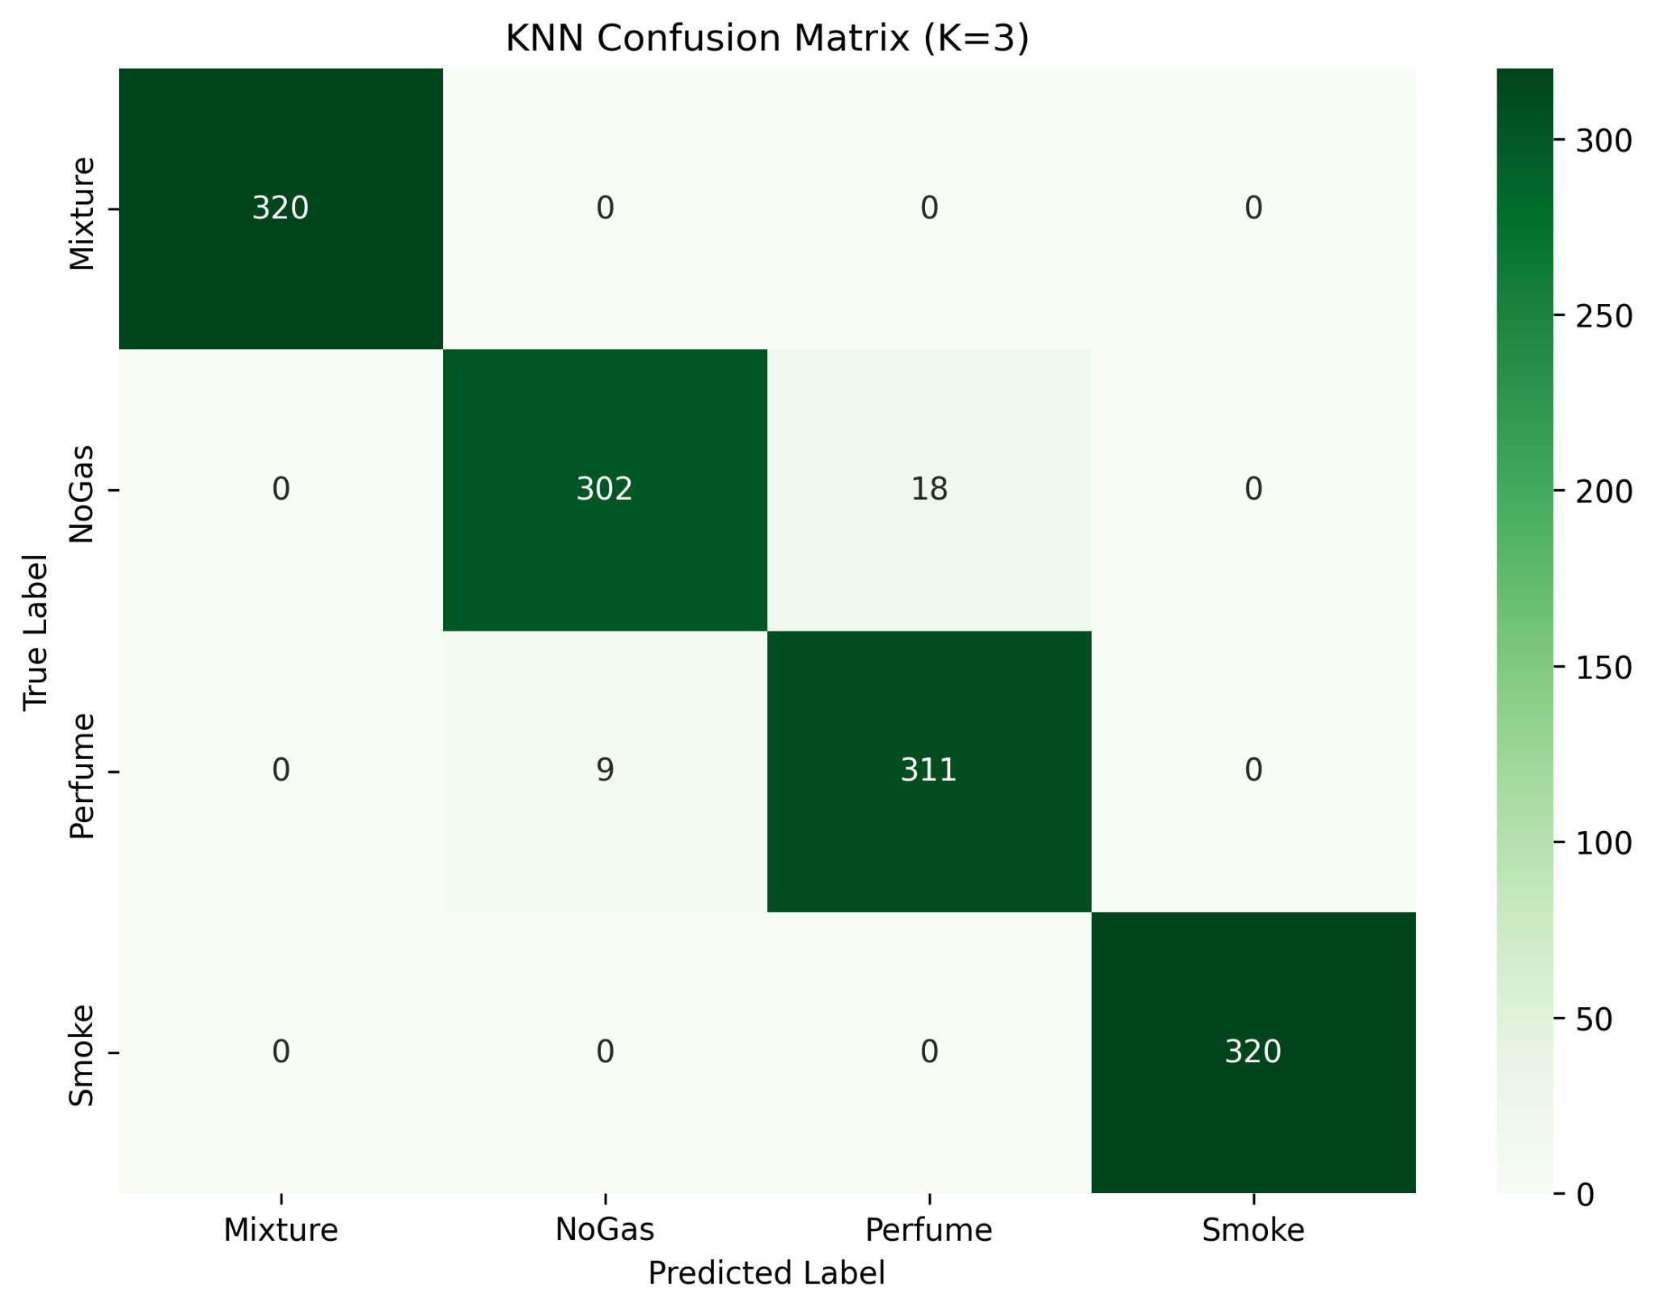
KNN

Slide 5
LSTM
Classification Report:
Gas Class | Precision | Recall | F1-Score | Support
Mixture | 1.00 | 1.00 | 1.00 | 320
NoGas | 0.89 | 0.94 | 0.92 | 320
Perfume | 0.94 | 0.88 | 0.91 | 320
Smoke | 1.00 | 1.00 | 1.00 | 320
Accuracy | - | - | 0.96 | 1280
Macro Avg | 0.96 | 0.96 | 0.96 | 1280
Weighted Avg | 0.96 | 0.96 | 0.96 | 1280
Final Test Accuracy: 95.70%

Slide 6
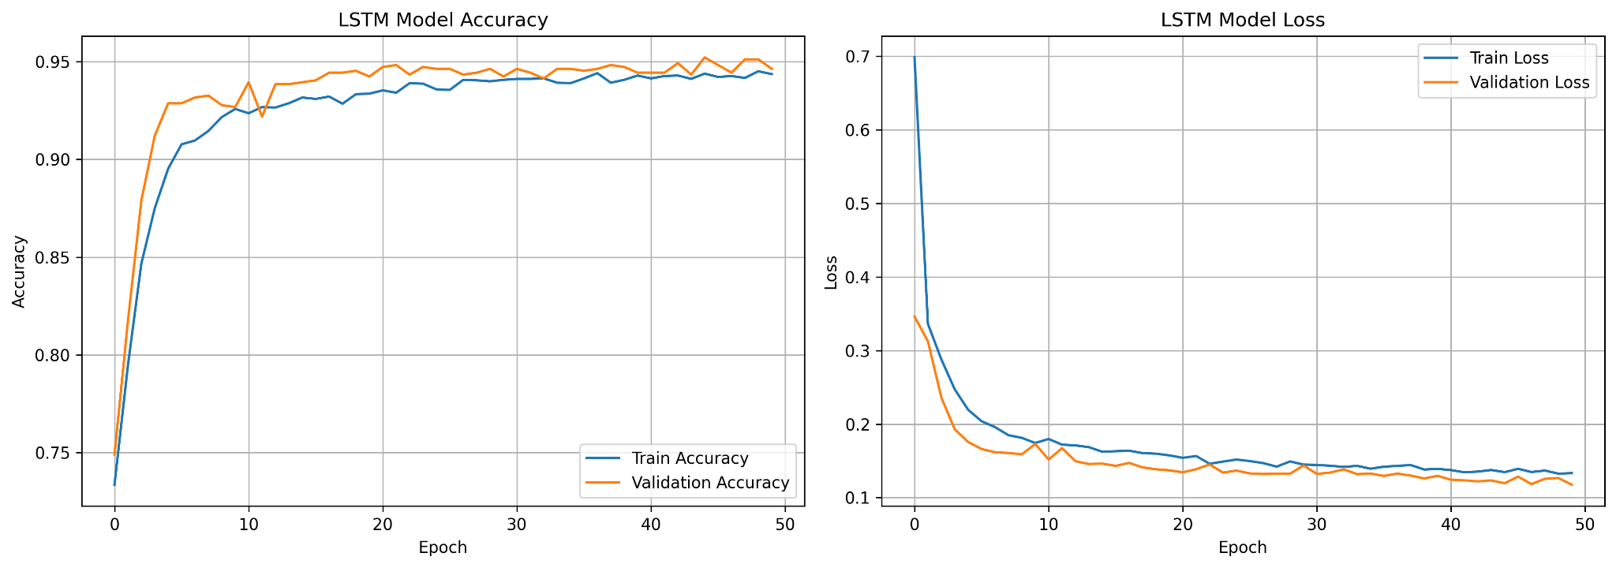
LSTM

Slide 7
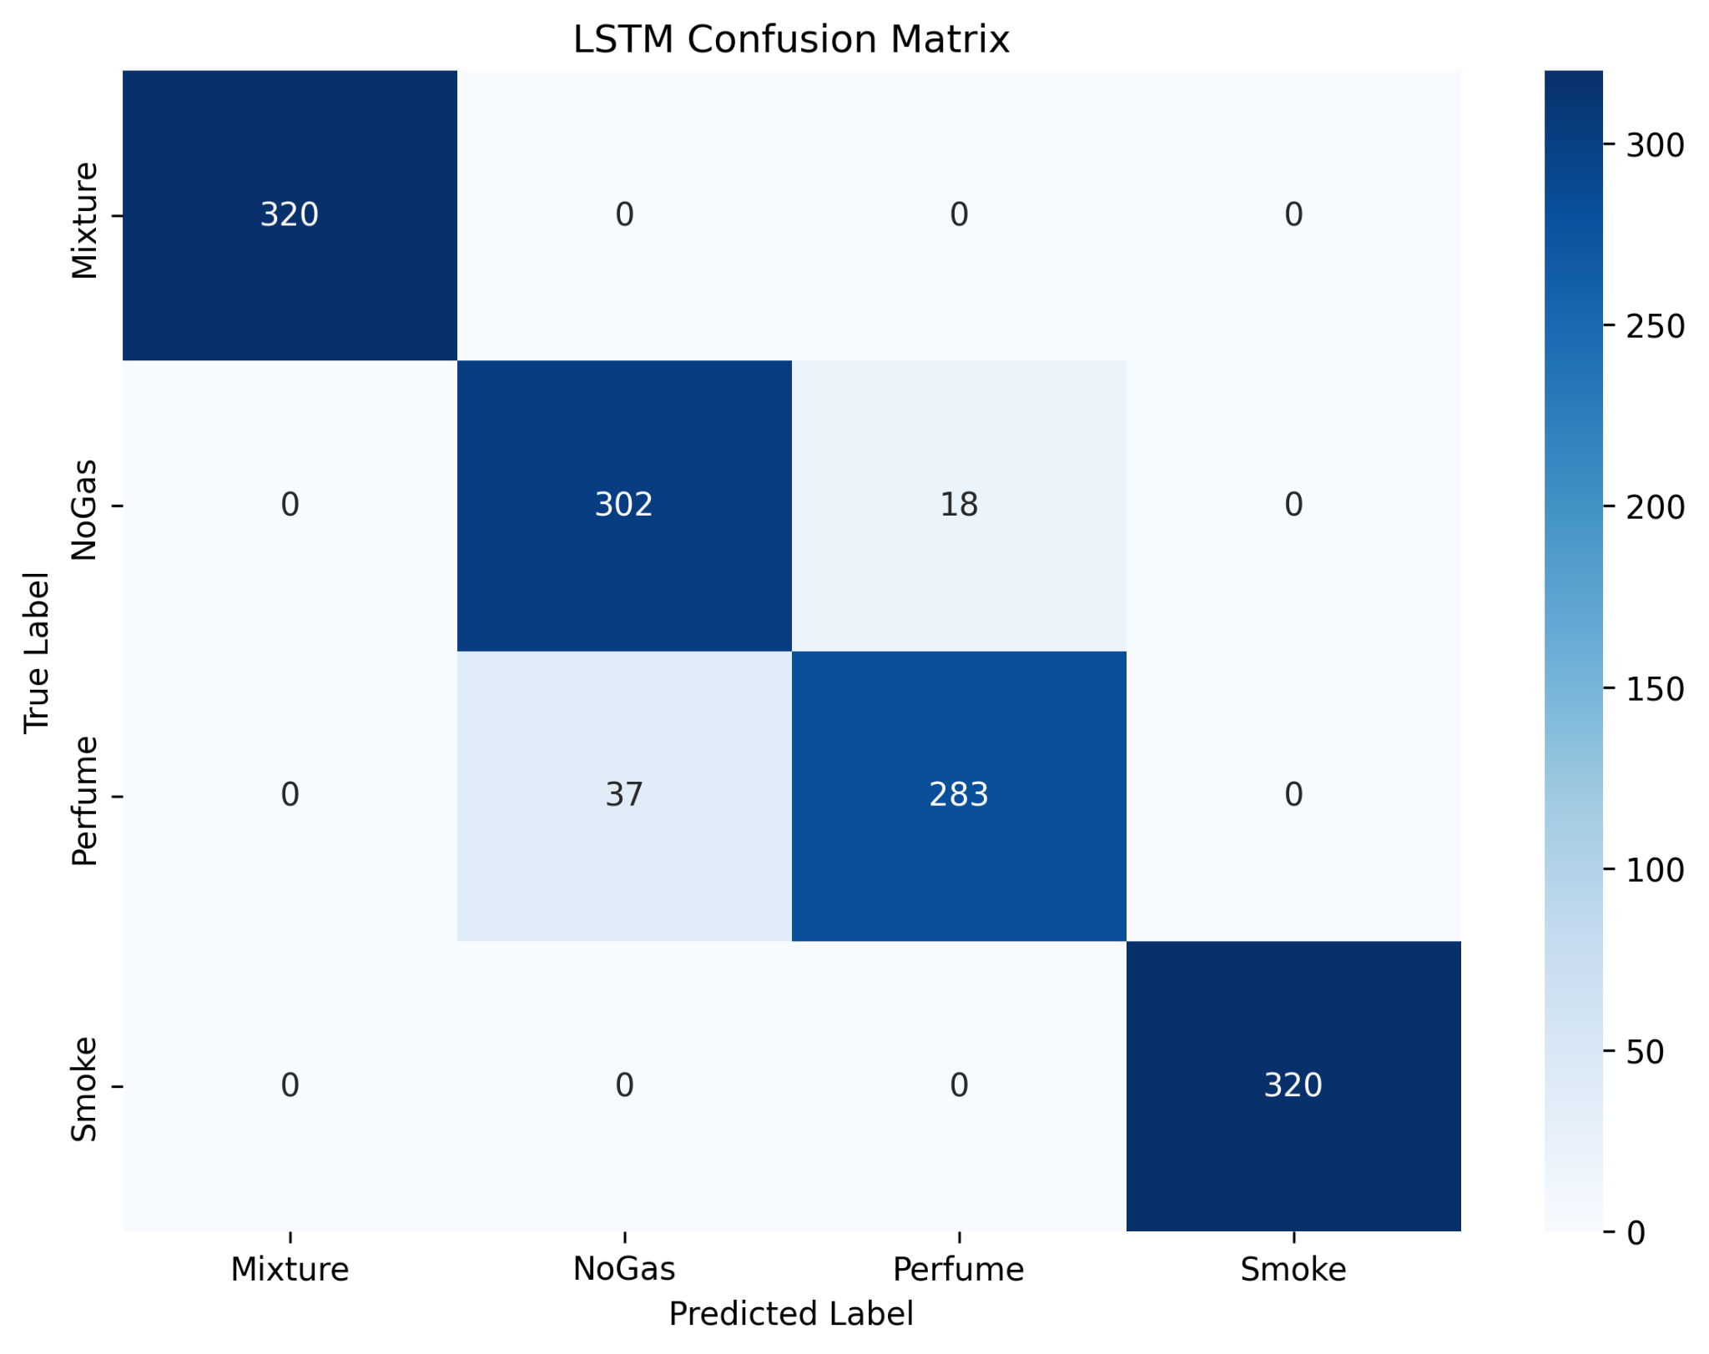
LSTM

Slide 8
SVM
Test Accuracy: 96.33%
Final Test Accuracy: 96.33%
Classification Report:
Gas Class | Precision | Recall | F1-Score | Support
Mixture | 1.00 | 1.00 | 1.00 | 320
NoGas | 0.91 | 0.94 | 0.93 | 320
Perfume | 0.94 | 0.91 | 0.93 | 320
Smoke | 1.00 | 1.00 | 1.00 | 320
Accuracy | - | - | 0.96 | 1280
Macro Avg | 0.96 | 0.96 | 0.96 | 1280
Weighted Avg | 0.96 | 0.96 | 0.96 | 1280

Slide 9
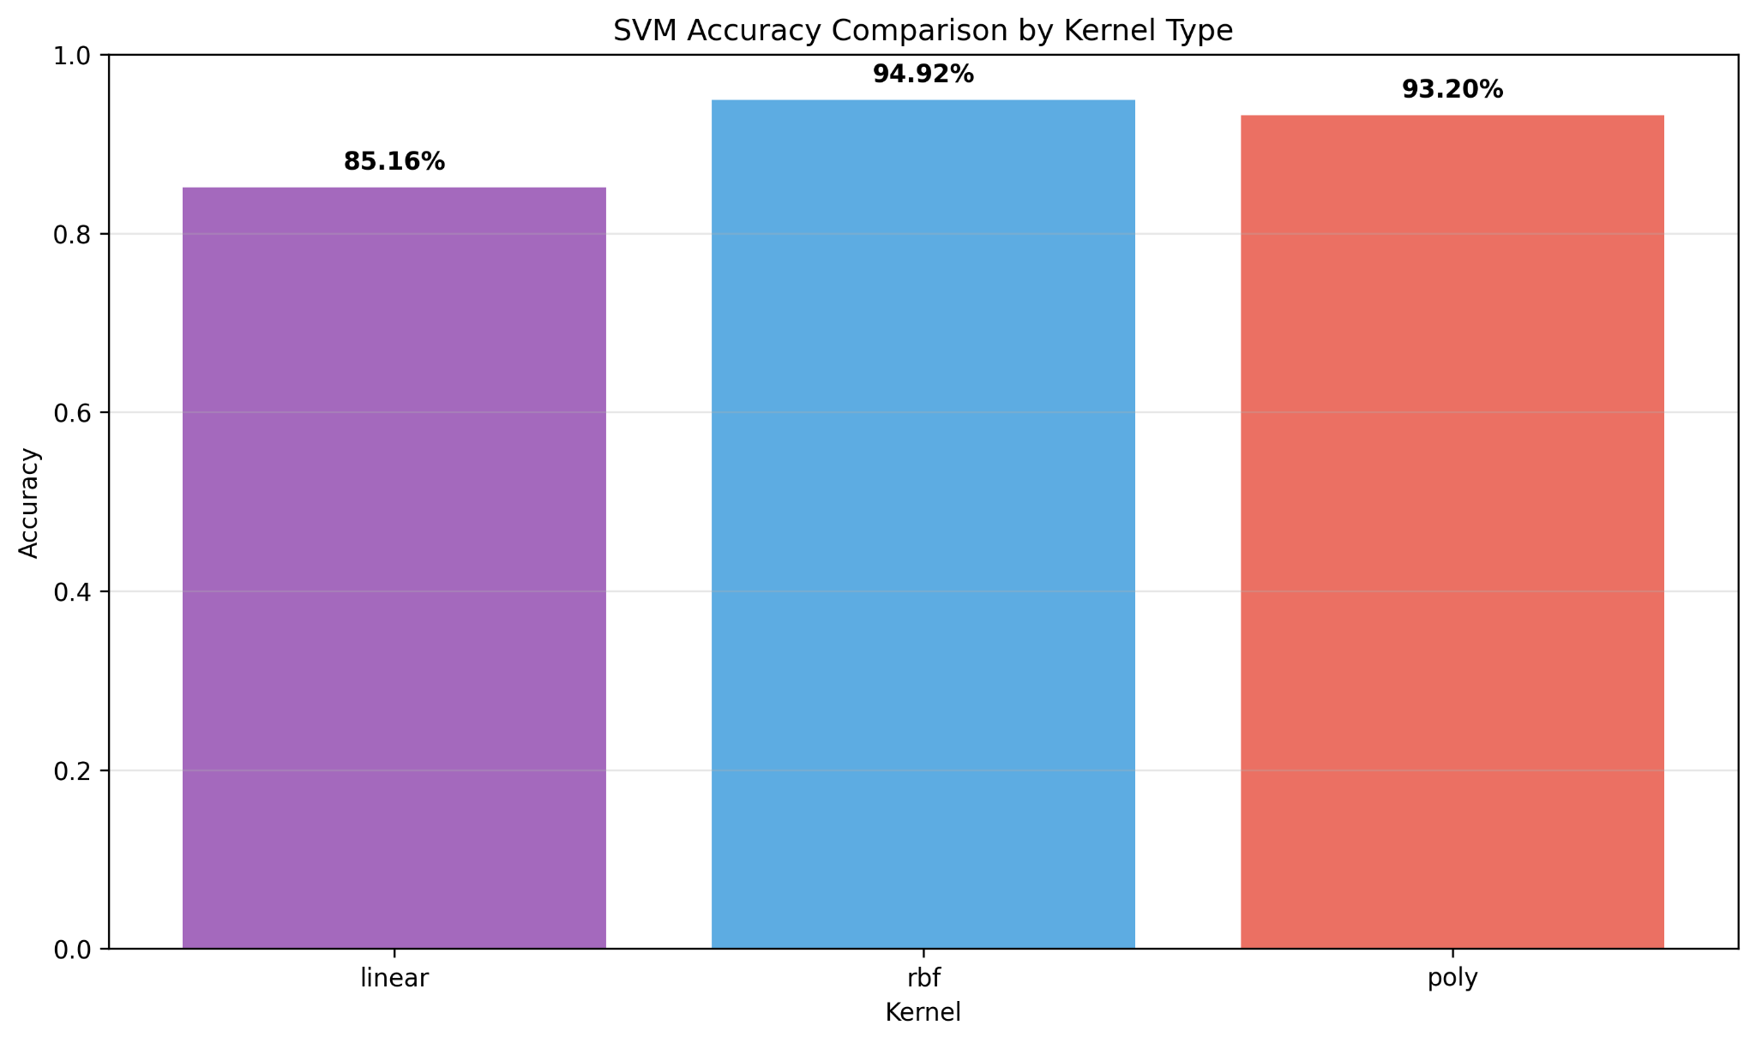
SVM

Slide 10
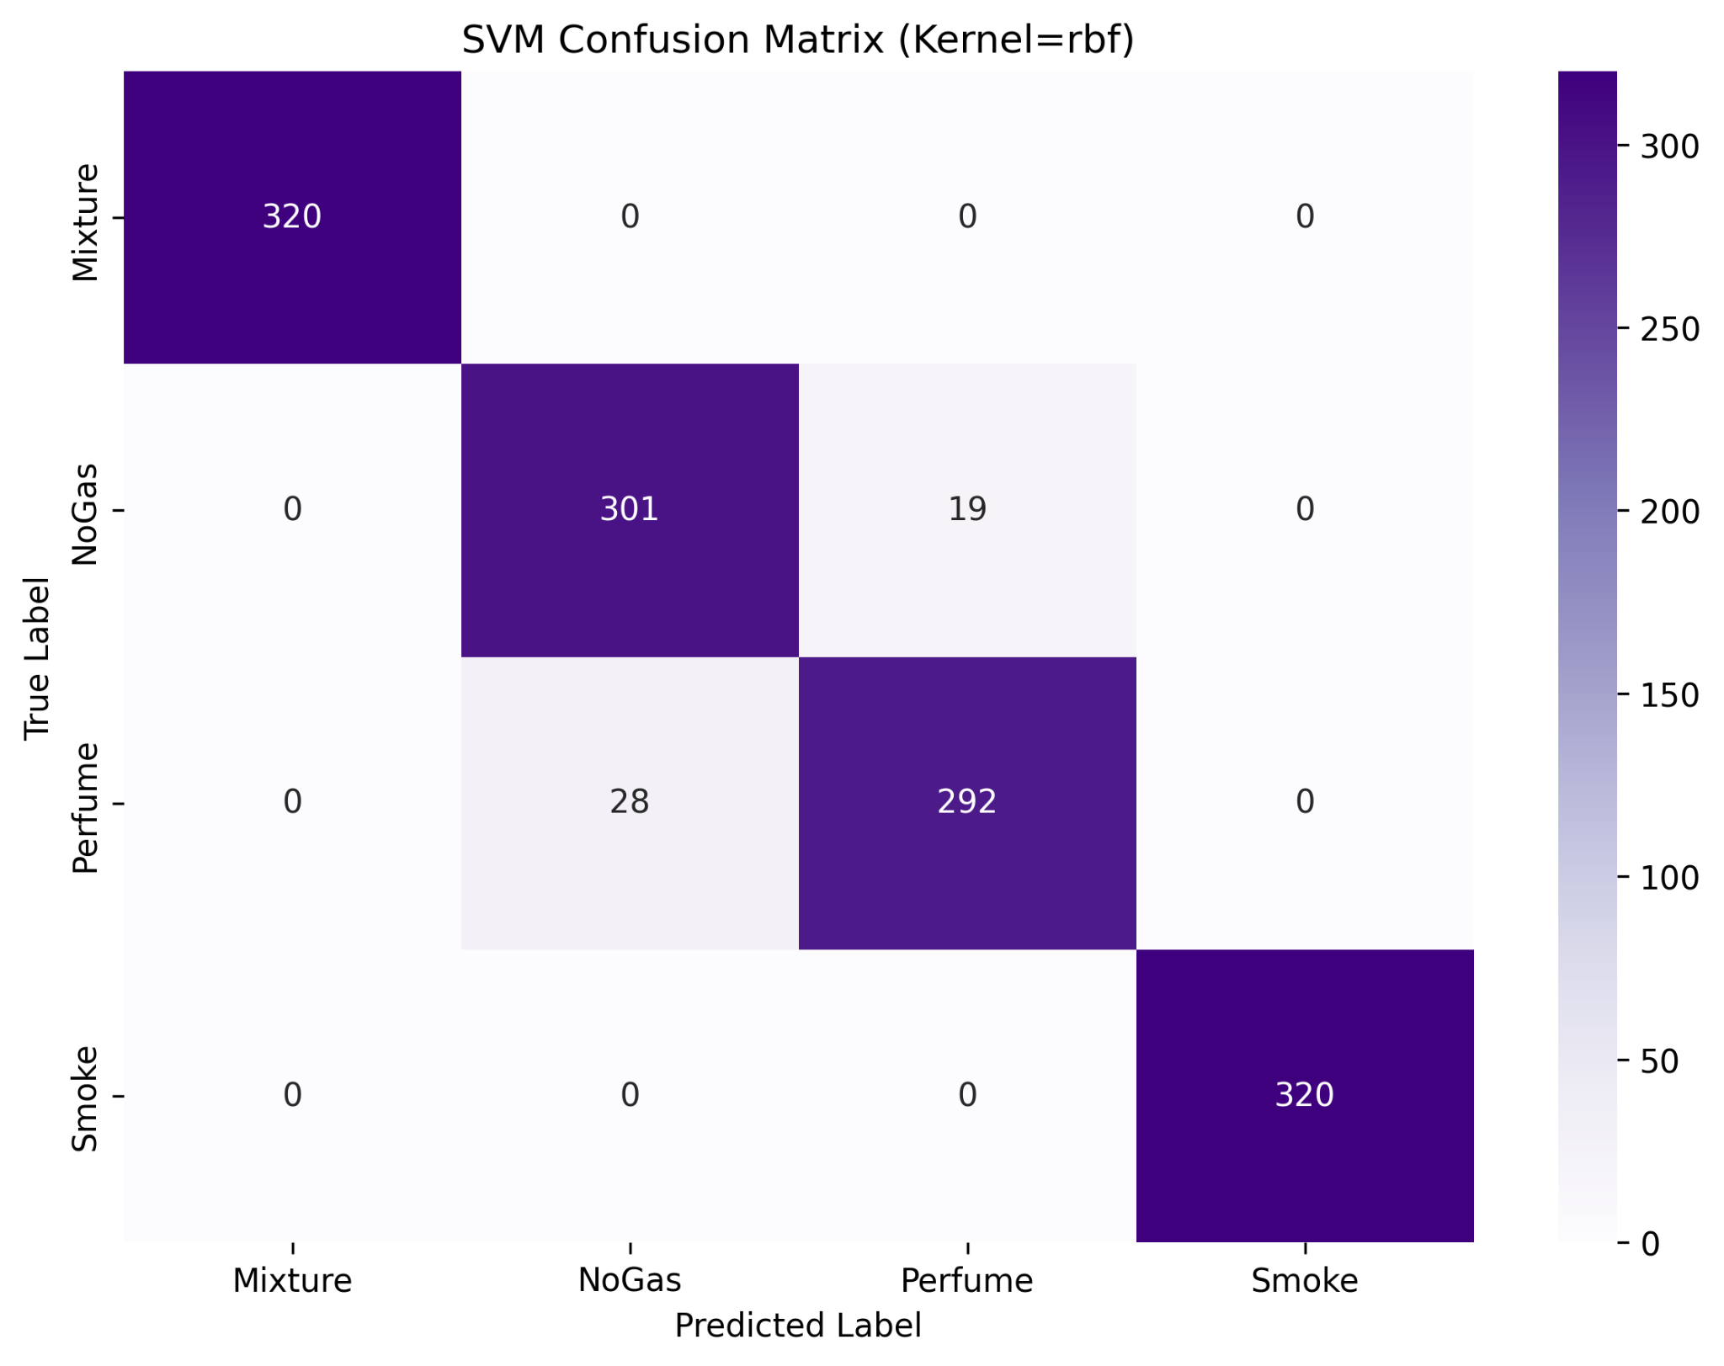
SVM

Slide 11
RF
Best parameters: {'max_depth': 30, 'max_features': 'sqrt', 'min_samples_leaf': 1, 'min_samples_split': 2, 'n_estimators': 100}
Best cross-validation score: 97.52%
Final Test Accuracy: 97.34%
Classification Report:
Gas Class | Precision | Recall | F1-Score | Support
Mixture | 1.00 | 1.00 | 1.00 | 320
NoGas | 0.95 | 0.95 | 0.95 | 320
Perfume | 0.95 | 0.95 | 0.95 | 320
Smoke | 1.00 | 1.00 | 1.00 | 320
Accuracy | - | - | 0.97 | 1280
Macro Avg | 0.97 | 0.97 | 0.97 | 1280
Weighted Avg | 0.97 | 0.97 | 0.97 | 1280

Slide 12
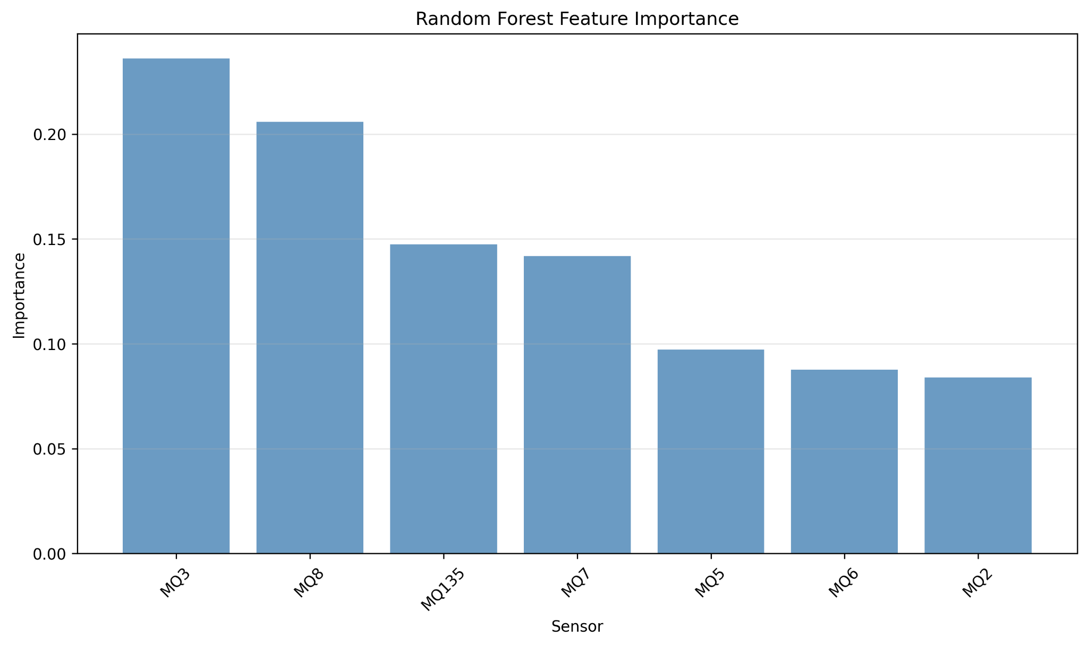
RF

Slide 13
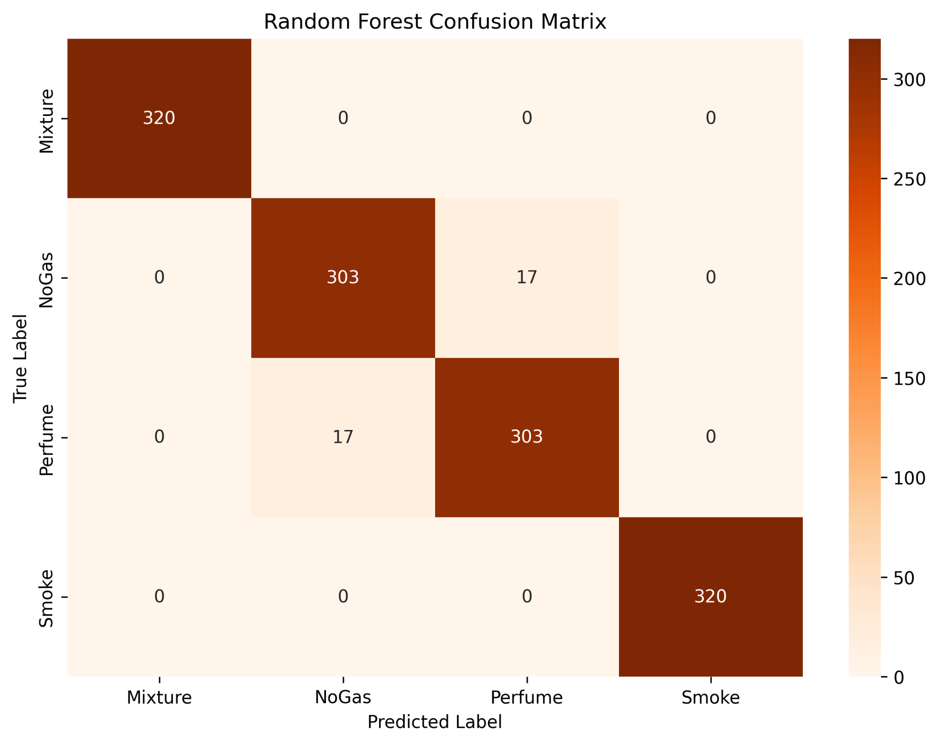
RF

Slide 14
Comparison of these ML algorithms with their best accuracy
SNO | Name | Accuracy
1 | KNN | 97.89
2 | LSTM | 95.70
3 | RF | 97.34

Slide 15
References
Dataset:

Slide 16
Citations
1. https://www.mdpi.com/2571-5577/4/1/3
2.https://pubmed.ncbi.nlm.nih.gov/39338648/
3.https://www.iieta.org/journals/i2m/paper/10.18280/i2m.230405
4.https://www.sciencedirect.com/science/article/pii/S0924424724005041
5.https://pmc.ncbi.nlm.nih.gov/articles/PMC8309760/

